Slide 1
Modular Instruments — Digital Multimeter(DMM)
Notes:
The slides from here to the first lesson slide are the standard front matter for any course. Any text in red should be replaced with text appropriate to your course.

Slide 2

What You Need To Get Started
Modular Instruments — Digital Exercise Manual
NI – DMM 3.0.5 or later
NI – Switch 4.4 or later
NI – DAQmx 9.4 or later
PXI – 4070 and test probes
PXI – 2503
TB – 2605
PXI controller
PXI chassis
Computer running LabVIEW 2011 or later and Windows XP or later

Slide 3
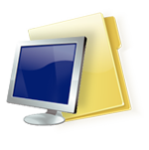
File Locations
Root Directory
Exercises <or> Solutions
DMM
Save the exercise files in the following location:
Notes:
Replace <Course Name> with the name of the course.

Slide 4
Instructional Methods
Lecture
Topic
Quizzes
Demonstrations
Concept Exercise
Development Exercise
Notes:
Lecture gives a foundation in the topic
Instructor reinforces foundation through demonstrations and quizzes
Use concept exercises to further explore a topic
Watch a simulation, experiment with example VIs
Use development exercises to gain hands-on experience
Demonstration of a finished development exercise further reinforces the learning process

Slide 5
Getting The Most Out Of This Course
Ask questions!
Experiment with hands-on exercises to understand the methods used
Explore solutions
Implementations explore a possible solution—you may find a better one

Slide 6
Course Learning Map
Lesson 1
Using the DMM
Lesson 2
Instrument Fundamentals
DMM Terminology
Lesson 3
Lesson 4
Lesson 5
Advanced DMM Topics
DMM and Switches
Notes:
<Replace text with your lesson titles. Click each smart art, press the left expand icon, and add or remove Lessons as needed. Resize the smart art to fit the actual number of lessons.>

Slide 7
Course Goals
This course prepares you to:
Configure and operate your DMM
Understand DMM specifications (accuracy, resolution, sensitivity)
Setup signal connections to the hardware
Use LabVIEW to program DMM applications
Use the functions on the NI-DMM function palette
Understand the DMM measurement cycle
Understand Advanced DMM specifications(Auto-Range, ADC Cal, Auto-Zero)
Use the DMM to control a switch (scanning)
Use the DMM/Switch Express VI
Notes:
Add course goals here. Refer to the Course Outline posted on ni.com/training.

Slide 8
Configuring Your LabVIEW Environment
Options Dialog Box
Controls/Functions Palettes page
Select Load palettes during launch to make Search Palettes immediately usable after launch
Set Palette to Category (Icons and Text)
Block Diagram page
Uncheck Place front panel terminals as icons to place control and indicator terminals in a compact format
Configure Block Diagram Cleanup to customize your block diagram
Notes:
This is an opportunity before the class starts for individuals to customize their environment with their favorite settings. The settings noted in the slide are suggested changes.
Other possible suggested changes based on instructor discretion:
Check Environment > General > Skip Getting Started window on launch
Uncheck Block Diagram>>Error Handling>>Enable automatic error handling in new VIs

Slide 9
Configuring Your LabVIEW Environment
Functions Palette
Tack the Functions palette and select Customize»Change Visible Palettes then click Select All and click OK
Controls Palette
Tack the Controls palette and select Customize»Change Visible Palettes then click Select All and click OK

Slide 10
Lesson 1 Instrument Fundamentals
DMM Instrumentation
DMMs versus DAQ
Common Measurements
Benefits of NI DMMs

Slide 11
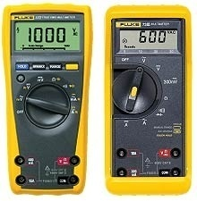
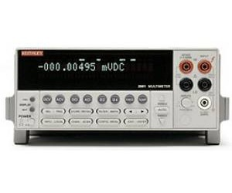
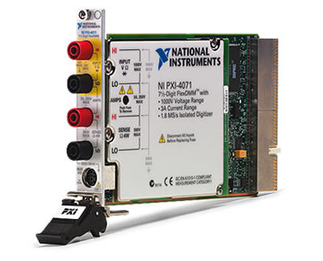
A. DMM Instrumentation
Handheld DMMs
3½ - 5½ digits
Portable, general purpose
Most Common
Benchtop DMMs
5½ - 8½ digits
Stationary, dedicated
Sometimes programmed with GPIB, LAN, USB, Serial
NI DMMs
5½ - 7½ digits
Stationary or Portable
PCI, PXI, USB,
Used with LabVIEW or text-based languages for Automated Test

Slide 12
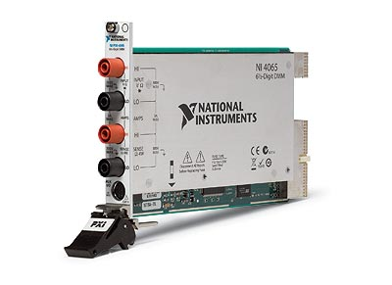
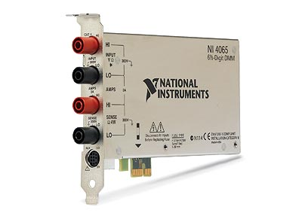
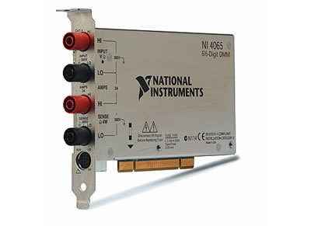
DMM Instrumentation
Digital Multimeters (DMMs) are specialized in taking flexible, high resolution measurements
Low to medium acquisition speeds
High resolution
Measures current or resistance in addition to voltage
Different form factors: PXI, PCIe, PCI, USB
Notes:
Digital Multimeters (DMMs) are widely used instrumentation in nearly all electrically based applications. These analog acquisition devices are specialized in taking flexible, accurate and precise measurements. Although though they feature relatively lower acquisition speeds they have high resolution and accuracy. National Instruments DMMs are also available in different form factors. For example, the 4065 family is available in the PXI, PCIe, and P USB form factors.

Slide 13
B. DMMs vs. Multifunction DAQ
Multiple Measurement Types
Higher resolution
Higher voltage and current ranges
Higher level of signal conditioning and isolation
DMMs do not specify a reading rate
Reading rate is dependent on configuration
Notes:
Although a multifunctional DAQ device can perform some of the same measurements, DMMs are analog input devices and have no capability for analog output or digital I/O.
Measurement Types – DMMs are specialized instruments designed to take precise measurements of voltages, currents and resistances. Some DMMs also measure impedance and capacitance. Multifunction DAQ devices typically measure only voltage.
Higher Resolution – NI DMMs use Sigma-Delta analog digital converters (ADCs) that allow them to make high resolution measurements, but results in a slower sampling rate. The DAQ device uses a different type of ADC which allows them to achieve faster sampling rates, but lower resolution. With NI DMMs you have 23-26 bit ∆∑ variable resolution vs. 12/16/18-bit fixed resolution of multifunction DAQ devices. With DMMs the higher the required resolution, the slower the sampling rate. With Multifunction DAQ devices the resolution remains fixed, however the sampling rate is variable.
Signal Conditioning – DMMs have a much higher signal conditioning and noise rejection capabilities compared with DAQ devices.

Slide 14
B. DMMs vs. Multifunction DAQ (cont) - Hidden
Notes:
Isolation – Isolation allows DMMs to operate in high voltage, high current (up to 1000VDC at 3A) and high common mode applications. Multifunction DAQ devices can only handle ±10V range.
Reading Rates – When using a Multifunction DAQ device you specify a sampling rate and the device returns an array of measurements taken at the specified rate. You do not directly specify the sampling rate of a DMM because the reading rate depends on how you configure the device. A single DMM measurement represents an average of many ADC samples over a period called the aperture time.
When using an NI DMM, there is no input to specify the sampling rate. The actual sample rate depends on the following parameters:
Resolution (number of digits)
Measurement Type (AC/DC, Voltage, Current, or Resistance)
Measurement Range (amplifier gain setting)
Enabled measurement options
There are so many different measurement configurations you could set in a DMM that for you to determine the reading rate you must benchmark your measurement.

Slide 15
C. Common Measurements
Primarily used for high resolution, slow sampling rate applications
DC Measurements | AC Measurement
Voltage Current Resistance Diode Measurement | RMS Voltage RMS Current Capacitance Inductance
Notes:
DMMs are primarily used for high resolution, slow sampling rate applications. This means DMMs are generally inappropriate for frequency domain measurements. The exception are NI DMMs with digitizer mode; this mode allows these devices to perform the same frequency domain measurements as a digitizer. The types of measurements that a DMM makes, can be broken down into the following two categories:
DC Measurements
DMMs can perform accurate and high-resolution measurements on DC signals. DMMs can measure the typical voltage, current and resistance measurements. It can also measure the voltage drop across a diode to perform diode tests.
AC Measurements
AC signals are often characterized by their RMS amplitude, which is a measure of their total energy. DMMs can measure the RMS value for voltage and currents of AC signals. In addition some NI DMMs can measure capacitance and inductance.

Slide 16
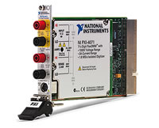
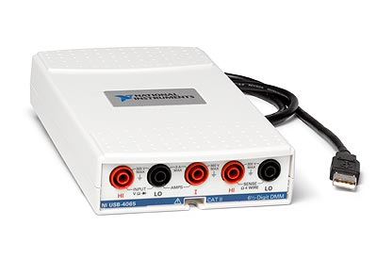
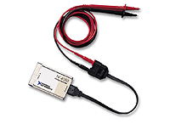
D. Benefits of NI DMMs
Software Support in NI LabVIEW and SignalExpress
The NI 407x series of DMMs offer unique capabilities
Isolated Digitizer Mode at up to 1.8 MS/s
Industry Leading Accuracy
2-year Calibration Cycle
USB-4065 & PCMCIA-4050 for portable measurements

Slide 17
Summary
DMMs used for high resolution, low acquisition speed applications
Capable of making various DC and AC measurements
Common measurements: voltage, current, resistance
Compared to a DAQ device, high level of signal conditioning, isolation, and range of operation

Slide 18
Lesson 2 DMM Terminology
Accuracy
Resolution
Sensitivity

Slide 19
A. Accuracy
Accuracy represents the uncertainty of a given measurement
Device Uncertainty is usually specified by the manufacturer in three ways:
(% Reading) + Offset
(% Reading) + (% Range)
±(ppm of reading + ppm of range)
1 ppm = 0.0001%
where ppm is parts per million
Notes:
Accuracy specifies the uncertainty of a given measurement. It represents how far the measurement may be from the real value. The accuracy of a measurement is calculated as the sum of the inherent measurement uncertainties of the device. In this course, we refer to uncertainty of the device as Device Uncertainty. The uncertainty generated by changes in the temperature is referred to as the Temperature Induced Uncertainty
The Device Uncertainty is usually specified in three ways:
(% Reading) + Offset
(% Reading) + (% Range)
±(ppm of reading + ppm of range)
where ppm stands for parts per million (1 ppm = 0.0001%)

Slide 20
Temperature Induced Uncertainty
Temperature Induced Uncertainty component considered when a measurement is made outside the calibrated temperature range
Measurements made ±5 ºC with respect to calibration temperature still accurate according to device specification
Temperature Induced Uncertainty calculated as product of temperature coefficients (Tempco) and temperature difference
Tempco is usually specified as: (ppm of reading + ppm of range) per ºC
Notes:
The Temperature Induced Uncertainty component is only considered when the measurement is made outside of the temperature range in which the boards were calibrated. For example, NI 4070 DMM is calibrated at a specified temperature. Measurements made ±5 ºC with respect to that calibration temperature will be accurate according to the device’s specification. If the board is being used in this range, the Temperature Induced Uncertainty should not be added to the Device Uncertainty.
The Temperature Induced Uncertainty is calculated as the product between Temperature Coefficients (Tempco) and the Temperature Difference. Tempco is usually specified as:
(ppm of reading + ppm of range)/ºC
The Temperature Difference is the difference between the temperature at which the reading was taken and the highest temperature at which the previous calibration was valid.

Slide 21
Calculating Accuracy: Example 1
Consider a measurement:
Made with NI 4070 calibrated at 23 ºC
6½ digit measurement of 5 VDC signal
Selected 10 V range
Within 2-year period of last calibration
What is the accuracy?
Notes:
Consider a measurement made with a NI 4070 calibrated to operate at 23 ºC. You are taking a 6½ digit measurement of a 5 VDC signal in the 10 V range. The device is still with in the 2-year period of the last calibration. What is your accuracy?

Slide 22
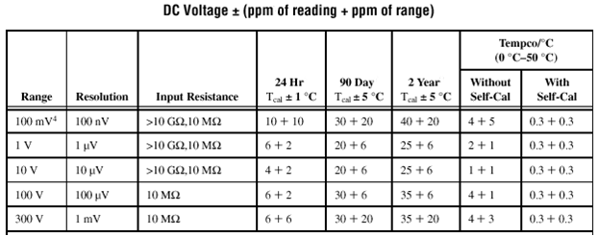
Calculating Accuracy: Example 1 Answer
Accuracy = ±(ppm of reading + ppm of range)
= ± (25 ppm x 5 V + 6 ppm x 10 V)
= ±185 µV
Notes:
The accuracy of your measurement is:
Accuracy= ±(ppm of reading + ppm of range) = ± (25ppm of 5 V + 6 ppm of 10 V) = ±185 µV
where ppm stands for parts per million (1 ppm = 0.0001% = .000001)
In the NI 4070, this uncertainty holds for temperatures within ±5 °C of the calibration temperature, this is, it holds for a temperature range between 18 °C and 28 °C.
Note: The 2-year accuracy holds as long as the user has run self-calibration every 90 days or when temperature has changed more than ±5 °C from the last calibration. Otherwise, you will need to add to all specifications 50 ppm of reading every 90 days and 3 ppm of reading/ºC.

Slide 23
Calculating Accuracy: Example 2
Consider taking a measurement in 38 ºC temperature.
Temperature Induced Uncertainty must be considered.
Accuracy = ± (25ppm of 5V + 6 ppm of 10V)
+ [(1ppm x 5V + 1ppm x 10V) × (38-(23+5))] = ±335µV
Notes:
However, if you take the same measurement at 38°C, you have to take into account the uncertainty added by the temperature difference. To do this, use the value listed under the Tempco Without Self-Cal column. The accuracy of the measurement becomes:
Accuracy= ± (25ppm of 5V + 6 ppm of 10V) + [(1ppm of 5V + 1ppm of 10V) × (38-(23+5))] = ±335µV
Note: Unlike the Tempco Without Self-Cal column, the temperature coefficient adjustments listed in the Tempco With Self-Cal never have to be added to the accuracy specifications listed in the 90 Day or 2 Year accuracy columns. They are provided for the user as a guideline to know the maximum ppm of reading and ppm of range that his measurement may move (all other measurement factors being the same) when self-calibrating at two different temperatures and reflect the temperature coefficient of the onboard voltage and resistor references. Expressed another way, this is the potential residual temperature drift when self-calibration is used, and it is already accounted for in the two absolute accuracy columns over the entire 0°C to 50°C ambient operating range.

Slide 24
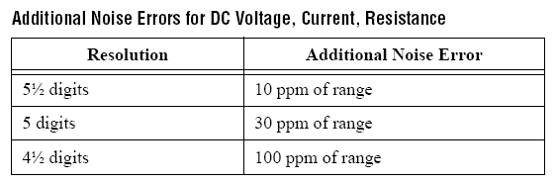
Calculating Accuracy: Example 3
Consider taking a 5 ½ measurement at 23 °C.
Accuracy = ± (25ppm x 5V + (6ppm + 10ppm) x10V) = ±285µV
Notes:
Now instead of the 6½ digit measurement of 5 VDC signal, measure with 5 ½ digit measurement at the original 23 ºC . The DMM would be configured for a shorter aperture time. This makes the reading more sensitive to noise, and therefore the accuracy of the reading decreases.
To calculate the resulting accuracy, add 10ppm to the uncertainty of the range, as shown in the Additional Noise Error table in the specifications:
Accuracy= ± (25 ppm of 5 V + (6 ppm + 10 ppm) of 10 V) = ±285 µV
Note: You do not add this additional noise error to the tempco coefficients.

Slide 25
B. Resolution
Resolution is the smallest change in an input signal that produces a change in the output.
Resolution is specified by the manufacturer in three units:
Bits
Absolute Units of Resolution (AUR)
Digits of Resolution
Notes:
DMMs are typically used when a highly accurate measurement is required. Therefore, resolution is often the most important specification to consider when evaluating a DMM.
Resolution is defined as the smallest change in an input signal that produces, on average, a change in the output signal. The resolution of a DMM can be specified in bits, absolute units or digits.

Slide 26
Bits of Resolution
In an ideal situation, only quantization noise is present, so resolution can be represented as bits of resolution.
Bits of resolution refers to the number of bits on the analog-to-digital converter (ADC).
Notes:
In an ideal situation where the only noise present in the system is due to quantization noise, the resolution of any device is a function of the number of bits on the analog-to-digital converter (ADC).

Slide 27
Absolute Units of Resolution
Absolute unit of resolution represents the minimum change in voltage a device can measure.
For a given voltage measurement range, the [noise-free] absolute unit of resolution is:
Total span for the Given Range (in volts)
____________________________________
Number of ADC quantization Levels (counts)
Notes:
The absolute unit of resolution (AUR) is calculated by dividing the total span of the measurement by the number of voltage steps the ADC can distinguish (count). The AUR represents the minimum change in voltage that the device can measure.
Graphing the AUR against a continuous input linear signal that covers the whole range.

Slide 28
Digits of Resolution
Traditionally, 6½ digits referred to the number of digits displayed on the readout of boxed instruments.
Now, Digits of Resolution is a calculation. This equation is in the Resolution topic in the DMM Help.
6½ Digit DMM
Full Digits (0-9): 6
Half Digit (0 or 1) : 1
09.99998 V DC
V
A
Hz
Ω
L
C
Notes:
Traditionally, 6½ digits referred to the number of digits displayed on the readout of a bench top digital multimeter. A 6½ digit multimeter would have six full digits that display values from 0 to 9 and one half digit that could only display 0 or 1.
This DMM could show positive or negative values from 0 to 1,999,999.
For more sophisticated digital instruments, and particularly virtual instruments, digits of resolution does not directly apply to the digits displayed by the readout. Therefore, care must be taken when specifying the number of digits for these measurement devices.
Now, digits of resolution is a calculation. The equation is in the Resolution topic in the DMM Help.

Slide 29
Noise and Digits of Resolution
Real-world systems, noise must be considered.
Higher level of noise produces lower effective resolution.
Effective Number of Digits (ENOD) includes this noise.
For example, a DMM ideally with 6 digits could be reduced to 5 digits. See Help file for these calculation.
Notes:
In reality, quantization noise introduced by the ADC is not the only source of noise. The added noise level must be accounted for when calculating the absolute units of resolution and effective number of digits. The higher the level of noise in the system the lower the effective resolution will be.
The RMS noise is the RMS value of all the noise present in the measurement. It is equivalent to the standard deviation of your measured data. To calculate the RMS noise, several measurements of the source signal are taken and statistical analysis is performed to calculate the mean and standard deviation. This value is then used to calculate the Effective Number of Digits (ENOD) of the DMM.
Use the following formula to calculate the Effective Number of Digits (ENOD) of a digital multimeter:
ENOD = log₁₀(total span / Effective absolute units of resolution)
where the effective absolute unit of resolution is calculated with the following formula:
Effective absolute units of resolution = √12 × rms noise

Slide 30
Relationship between Measures of Resolution
NI 4071
DMM
Traditional
DMM
16-bit DAQ
PXI-4472
(DSA)
FlexDMM
7
Notes:
This graphic illustrates the relationship between bits, counts, ENOD, and Digits of Resolution for the different NI Digital Multimeter products.
It is important to remember that there is not a direct mathematical relationship between ENOD and the number of bits. Digits are used as approximations.

Slide 31
C. Sensitivity
Smallest change that can be meaningfully detected with the instrument .
For example, assume the sensitivity of a digital multimeter is 100 nV. With this sensitivity, the digital multimeter can detect a 100 nV change in the input voltage.
Notes:
Sensitivity is the smallest unit of a given parameter that can be meaningfully detected with the instrument when used under reasonable conditions.
For example, assume the sensitivity of a digital multimeter in the volts function is 100 nV. With this sensitivity, the digital multimeter can detect a 100 nV change in the input voltage.

Slide 32
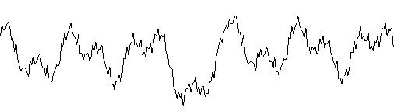
Summary – Quiz
Match the term to the aspect of the measurement.
Accuracy ___
Resolution ___
Sensitivity ___
True Measurement
C
B
A
Ideal Measurement
Notes:
Accuracy → B: represents the uncertainty of a given measurement
Resolution (ADC Counts) → A: the smallest change in an input signal that produces, on average, a change in the output signal.
Sensitivity → C: is the smallest unit of a given parameter that can be meaningfully detected with the instrument when used under reasonable conditions.

Slide 33
Lesson 3 Using the DMM
DMM Connections
Soft Front Panel
DMM Programming Flow

Slide 34
A. DMM Connections
DMMs are used when accurate and high-resolution measurements are required
Common DMM Measurements:
Voltage
Current
Resistance

Slide 35
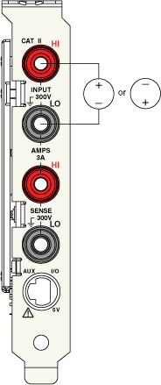
DMM Connection: Voltage Measurement
NI DMMs can make DC and AC voltage measurements
Connect the voltage to be measured to the top two HI and LO input connectors
Measurement concerns:
Offset voltage
Noise rejection
For more information on:
DC Voltage Measurements
AC Voltage RMS Measurements
Notes:
A digital multimeter can be used as a voltmeter to determine the potential voltage difference across several leads of an electrical component or from a lead referenced to ground. To measure the voltage across two leads, place the positive terminal on the lead with higher voltage (if known) and the negative terminal on the lead with a lower voltage. To measure the voltage of a specific location referenced to ground, connect the positive terminal to the desired location and the negative terminal to ground. When used as a voltmeter, the digital multimeter has a very large input impedance and thus draws very little current.
DC Voltage Measurements
http://zone.ni.com/devzone/cda/tut/p/id/3226
AC Voltage RMS Measurements
http://zone.ni.com/devzone/cda/tut/p/id/2966

Slide 36
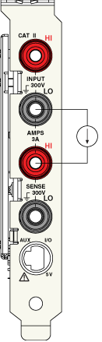
DMM Connection: Current Measurement
For all ranges, current flows through onboard precision shunt resistor.
Measurement concerns:
Generated currents
Leakage current
Burden voltage
For more information on
DC and AC Current Measurements
Notes:
A digital multimeter can be used as an ammeter to determine the current flow through a wire or electrical component. This measurement is accomplished by placing the digital multimeter in series with the wire that the current is flowing through. When used as an ammeter, the digital multimeter has a very small impedance (resistance) resulting in a small voltage drop across the multimeters leads.
DC and AC Current Measurements
http://zone.ni.com/devzone/cda/tut/p/id/3225

Slide 37
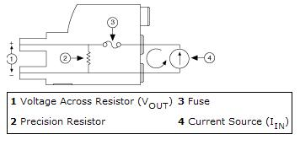
DMM Connection: Current Measurement
Use a current shunt module for making measurements outside specified range.
Current Shunt Modules:
NI CSM-10 A (0.01 Ω sense resistor)
NI CSM-200 mA (1.0 Ω sense resistor)
When using external shunt set the voltmeter to DC V and perform conversion to current in SW.
Notes:
When taking current measurements outside of the specified range on NI 4070/4071/4072, you must use a current shunt module. NI offers the NI CSM-10A and the NI CSM-200mA current shunt modules. The NI CSM-10A has a 0.01 Ω sense resistor, and the NI CSM-200mA has a 1.0 Ω sense resistor.
To take measurements using an external shunt:
Set the voltmeter to DC voltage and measure the current in software using Ohm’s Law:
I_{IN} = (V_{OUT})/R
where:
I_{IN} is the input current
V_{OUT} is the voltage across the precision resistor
R is the resistance of the precision resistor

Slide 38
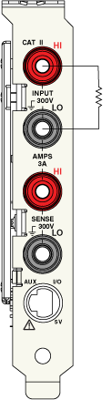
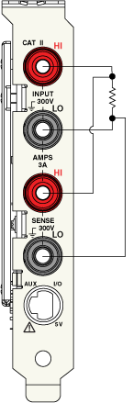
DMM Connection: Resistance Measurement
NI DMMs are capable of making 2-wire and 4-wire resistance measurements
Measurement Concerns:
Lead resistance
Thermal EMF
Parallel resistance
For more information on
Resistance Measurements
Notes:
A digital multimeter can be used as an ohmmeter to measure resistance of an electrical component. This measurement is accomplished by placing the digital multimeter's terminals across the electrical component where a resistance measurement is to be taken. When switched to the ohmmeter setting the digital multimeter develops a small known voltage between its terminals. When a resistor is connected across these terminals a current will flow. The digital multimeter then measures this current and the resistance is calculated using Ohm's Law (V = I × R).
The 2-wire method is commonly used as it is the simplest and most straightforward method. Using the 2-wire method, you can get accurate measurements above 100 kΩ relatively easily. For lower resistance values, such as 100 Ω, the interconnecting cabling can add significant resistance which can greatly affect your measurement. Copper is the most common and is the recommended cabling. Copper has a temperature coefficient in the 3,000 ppm/°C range, which can add instability to the measurement.
For precision measurements with resistances below 100 kΩ, the 4-wire mode is more accurate than the 2-wire mode. The 4-wire mode requires 4-wire switching and more cabling; however, you may decide the tradeoff is acceptable, depending upon the accuracy versus complexity requirements of your system.
Resistance Measurements
http://zone.ni.com/devzone/cda/tut/p/id/3981

Slide 39
B. NI-DMM Soft Front Panel
Make measurements without any programming
Installed with NI-DMM driver
Notes:
The NI-DMM Soft Front Panel (SFP) utility is shipped with all NI DMM devices. It is installed when you install the NI-DMM driver. The Soft Front Panel is an interactive tool that allows you to make quick measurements without having to use an application development environment (ADE) to program your device.

Slide 40
Exercise 3-1: Using the NI-DMM Soft Front Panel
Measure the resistance using the NI-DMM Soft Front Panel
Notes:
Have the students turn to Exercise 3-1 in their DMM exercise manuals and complete the exercise.

Slide 41
C. NI-DMM Programming Flow
Programmed with NI-DMM driver
Support in the following Application Development Environments:
LabVIEW
LabWindows/CVI
Microsoft Visual Basic
Microsoft Visual C++
Notes:
NI DMM hardware is programmed with the NI-DMM driver. The driver provides support for LabVIEW, LabWindows/CVI, Microsoft Visual Basic and Visual C++ application development environments. In this course we will only be discuss programming the DMM hardware in the LabVIEW environment.

Slide 42
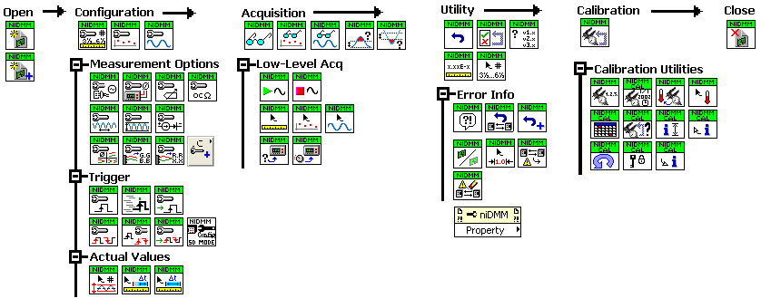
NI-DMM Programming Flow
Notes:
The NI-DMM driver provides many VIs for programming NI DMMs. The NI DMM palette contains VIs to initialize and close NI-DMM sessions, as well as the NI-DMM property nodes and a number of subpalettes.
All NI-DMM programs have four essential parts: initialization, configuration, acquisition, and closing of the session.

Slide 43
NI-DMM Programming Flow: Initialize
niDMM Initialize –Opens a session to the DMM
niDMM Initialize With Options –Opens a session to a Simulated DMM
Notes:
All NI-DMM VIs use a NI-DMM instrumentation handler as an input. Programming DMM hardware, begins with calling the niDMM Initialize VI or niDMM Initialize with Options VI. Both these Vis initialize the instruments, create an instrument handle, and allow you to reset or query your device. The niDMM Initialize with Options VI allows you to specify an options string to configure additional settings, such as range, checking, caching, coercion recording, simulation, and status reporting. The initialize VIs have an instrument descriptor input that accepts traditional NI-DAQ instrument descriptors, DAQmx resources names, and IVI virtual instrumentation or logical names. Traditional NI-DAQ resources are used by older DMMs and are assigned by the NI-DAQ driver. An example of a traditional resource name is DAQ::1. Newer devices use DAQmx resources names. You can assign DAQmx resources names in Measurement & Automation Explorer (MAX). The IVI Configuration Utility creates IVI virtual instruments or logical names.

Slide 44
NI-DMM Programming Flow: Configure
High Level VIs
Digitizer mode:
Function
Range
Sampling Rate
DMM mode:
Function
Range
Resolution
DMM mode:
Multi-point acquisitions
Notes:
The configuration palette contains VIs for configuring the settings of the DMM. There are three high-level configuration VIs. The niDMM Configure Measurement VI configures a standard, single-point DMM mode acquisition. A multi-point acquisition in DMM mode is achieved by first using the niDMM Configure Measurement VI to configure the Function, Range and Resolution. Then follow with the niDMM Configure Multipoint VI to specify the number of points to acquire. The niDMM Configure Waveform VI programs the DMM for digitizer mode, making it possible to acquire a waveform.
When using high level Vis to configure a measurement, then the NI-DMM driver sets default vales for the measurement option functions and for the trigger and measurement complete signals. The default values for the measurement option functions depend on the configuration of the measurement, and are documented in the Measurement Options book of the NI Digital Multimeter Help.
For the NI 4070, the default value of the trigger source is IMMEDIATE and its default slope is negative. The default value of the measurement complete signal is NONE and default slope is negative.

Slide 45
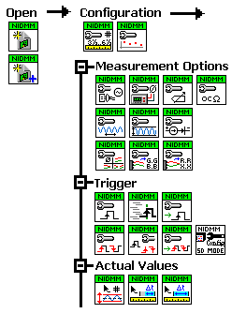

NI-DMM Programming Flow: Configure
High Level VIs
Measurement option functions:
AutoZero
ADC Calibration
PowerLine, and so on
Low Level VIs
Input Trigger: source and slope
Measurement Complete: destination and slope.
For example, niDMM Get Measurement Period
Notes:
In addition to the high level VIs there are a set of low level VIs that allow you to program more specific applications. The Measurement Options palette contain Vis for configuring specific measurements, such as the current source for diode measurements, as well as Vis for controlling the DMM measurement cycle. You can programmatically set the value of the different parts of the measurement cycle of the DMM, with functions such as niDMM Configure ADC Calibration, niDMM Configure AutoZero, niDMM Configure Offset Comp Ohms, niDMM Configure Powerline Frequency, etc.
The Trigger Palette contains VIs to trigger the start of the measurement from an external source, or send a trigger to an external source when the measurement completes.
The VIs in the Actual Value palette give you access to values that the NI-DMM driver determines programmatically. The niDMM Get Measurement Period VI in the Actual Value palette can benchmark the measurement period.

Slide 46
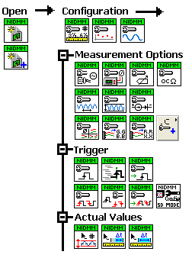
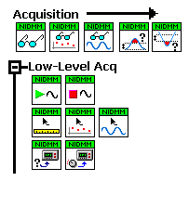

NI-DMM Programming Flow: Acquisition
High Level VIs
Low Level VIs
Read = Initiate + Fetch
Notes:
The Acquisition palette contains functions for collecting data form the DMM. The niDMM Read VI returns a standard, single point measurement from the DMM. The niDMM Read Multi Point and Read Waveform Vis are used to return multiple points measurements. These high level Vis initiate an acquisition, read the acquired data, stop the acquisition, and return control to your program. They do no return control to your program until all of the requested data has been acquired.
The low level Acquisition palette contains Vis for separating the start of an acquisition from the reading of the values. Using these VIs, a measurement or acquisition is initiated at one point in the t program and the results are returned later by calling a separate VI.
For more complex methods of acquiring data, use niDMM Initiate and niDMM Fetch, niDMM Fetch Multipoint or niDMM Fetch Waveform. niDMM Read combines niDMM Initiate and niDMM Fetch into one call. niDMM Read is suitable of simple acquisitions. niDMM Initiate/niDMM Fetch is better suited for complex applications that involve scanning and/or triggering.

Slide 47
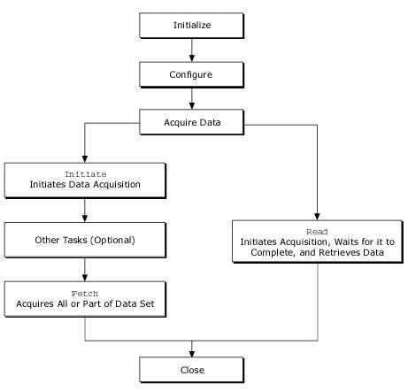
DMM Acquisition - Read vs. Fetch
niDMM Read–Combines niDMM Initiate and niDMM Fetch into one call
niDMM Initiate–Returns control to program, thus freeing up processor for other tasks while DMM is acquiring data
niDMM Fetch–Transfers acquired data from RAM to your application
Notes:
After initializing and configuring your DMM acquisition can be programmed with: niDMM Read or using niDMM Initiate and niDMM Fetch
niDMM Read
niDMM Read initiates an acquisition, reads the acquired data, stops the acquisition, and returns control to your program. niDMM Read does not return control to your program until all of the requested data has been acquired.
niDMM Initiate and niDMM Fetch
Use niDMM Initiate and niDMM Fetch for a more flexible method for acquiring data, offering several advantages over niDMM Read. With niDMM Initiate, you can perform other operations while the DMM acquires data. niDMM Fetch retrieves the acquired data.
After executing niDMM Initiate, the DMM begins acquiring data and sending it to your computer RAM. Meanwhile, control is returned immediately to your program, which frees up the computer processor for other tasks.

Slide 48
C. DMM Acquisition - Read vs. Fetch (cont.) - Hidden
Notes:
After niDMM Initiate, call niDMM Fetch. niDMM Fetch waits until the requested data has been acquired. niDMM Fetch transfers the acquired data from memory to your application. You can check the number of points that have been acquired every so often using the function niDMM Check Status, and once enough points have been acquired, you can call the Fetch function to retrieve them from the memory to your application.
If the data is not acquired within the time specified with the timeout parameter, NI-DMM returns an error. If you want to stop the DMM before it finishes, use niDMM Abort.
For more information, refer to the Acquiring Data topic in the NI Digital Multimeter Help.

Slide 49
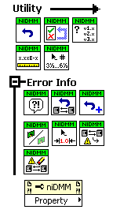
NI-DMM Programming Flow: Utility Palette
Self Test
Reset
Formatting functions
Utility palette contains tools to reset the device, test the device, and other functions.
Notes:
The Utility palette provides many useful tools to reset the device, test the device and other miscellaneous functions.
Reset – allows you to set your DMM to a know configuration state (DC V).
Self Test – useful for testing your hardware functionality, it will test to see if fuse needs replacing or if the board needs to be sent for repair.
Formatting functions – show your readings with the appropriate number of digits etc.
The property node, although not on the utility palette, allows you to access properties of your DMM such as input resistance.

Slide 50
NI-DMM Programming Flow: Close
Notes:
End all DMM programs with the niDMM Close VI to close the session to your DMM.

Slide 51
Self-Calibration
To demonstrate how to find out calibration information and Self-Calibrate a 407x DMM.
Notes:
Follow the instructions in <Exercises>\DMM\Demonstrations\SelfCalibration_DemoScript.doc

Slide 52
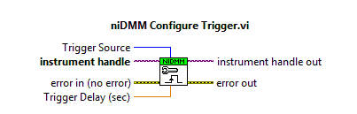
D. Programming with NI-DMM
Single Point Measurement
After configuration, the DMM enters the idle state.
Once it is initiated, the DMM waits for a trigger.
Use niDMM Configure Trigger to specify trigger source and delay. The default trigger source is Immediate.
Notes:
Programming with NI-DMM >> Features >> Triggering >> Single Point Acquisition

Slide 53
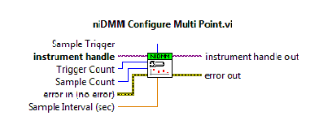
Programming with NI-DMM: Multipoint Measurement
Multipoint Measurements
2 triggers
Use niDMM Configure MultiPoint to configure:
Sample Trigger source (default is Immediate)
Sample Trigger counts (default is 1)
Trigger counts
Notes:
Therefore, if you wanted to take 100 samples, you could configure the Trigger Count=10 and Sample Trigger=10.
To configure the 4070 for multipoint acquisition, set Trigger Count to its default value (1) and set the Sample Count to the number of samples you want to acquire
NI-DMM Help >> Programming with NI-DMM >> Features >> Triggering >> Multi-point acquisition

Slide 54
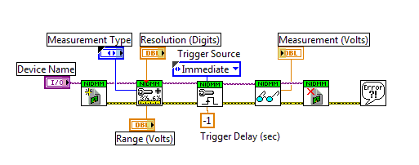
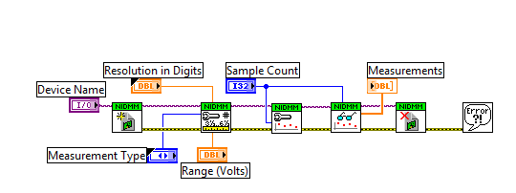
Programming with NI-DMM
Finite Measurements
In this example, sample count determines the number of samples acquired.
Notes:
This slide shows a single point measurement on top and a multipoint measurement on bottm.
The default value for Trigger source is IMMEDIATE.
The default value for their counts is 1.

Slide 55
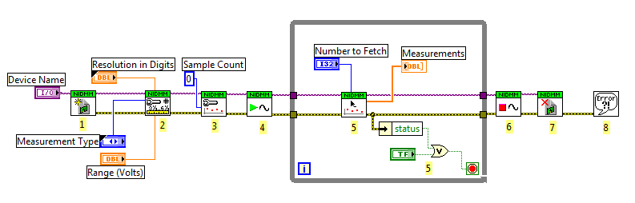
Programming with NI-DMM
Continuous Measurements
Notes:
407x >> Set either sample count or trigger count to 0
This program is the same as multi point acquisitions (refer to flow chart) except that the trigger loop or the sample trigger loop are continuous.
In the 407x, if choosing the trigger source and the sample trigger source to be external, both signals need to be coming from the same pin. This is you cannot export an external trigger through TTL1 and an external sample trigger from TTL2. You will need for both the trigger and the sample trigger to come from the same external source.
Most commonly, one of the triggers will be chosen to be external, and the other will be set to either interval, immediate or software trigger.
Continuous acquisitions cannot be performed using waveform mode.
To end a continuous acquisition, you must call niDMM Abort.

Slide 56
Programming with NI-DMM : Sampling Rate
How do I set the Sampling Rate in DMM mode?
Reading rate is not set directly. It is determined by:
Resolution (higher resolution = slower rate)
Function (for example, AC measurements take longer than DC measurements)
Range (settling time)
Enabled measurement enhancement functions
This results in large number of different configurations
Therefore, you need to benchmark the measurement period.
Notes:
In general, higher resolution gives you slower measurements.
If you perform a single-point measurement, it will usually take much longer to acquire than individual samples in a multi-point acquisition. On a multi-point acquisition, it generally takes a longer time to acquire the first point than it does to acquire each subsequent point. This initial delay is especially long on AC measurements.
With a DAQ board, you can specify the sampling rate directly.
When using an NI DMM, there is no input in the API for specifying a sampling rate. The actual sample rate you will get on any acquisition depends on the following parameters:
Resolution (number of digits)
Measurement Type (AC/DC, Voltage, Current, or Resistance)
Measurement Range (amplifier gain setting)
Powerline Filter Setting (filter out 50 Hz or 60 Hz powerline noise)
Enabled measurement options
There are so many different measurement configurations you could set in a DMM that in order for you to know the reading rate it is necessary to benchmark your measurement.

Slide 57
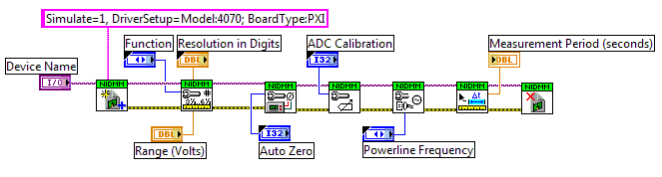
Programming with NI-DMM – Sampling Rate
How do I set the Sampling Rate in DMM mode?
You can use simulation mode to benchmark measurement periods:
Use niDMM Initialize with Options to open a session to a simulated device
Use niDMM Get Measurement Period to benchmark measurement
Notes:
NI-DMM allows you to simulate the NI 407x and NI 4065.
The niDMM Initialize with Options function allows you to pass the parameter “option string” to the device. You can use this parameter to set the initial value of certain properties for the session. One of these attributes is the simulation attribute.
Simulating your DMM is particularly useful if you are developing your application and the hardware you are using is unavailable. For example, simulation allows you to benchmark the scanning rate of your DMM, without actually having the device installed in your system.
To simulate a device, complete the following steps:
Use niDMM Initialize with Options function. Use any device number for your simulation, for example PXI1Slot4 or Dev3.
Add "Simulate=1,DriverSetup=Model:[4050, 4070, 4072]; BoardType:[PCMCIA, PCI, PXI]" to the Option String.
For example, to simulate the PXI-4070, the option string would be: "Simulate=1, DriverSetup=Model:4070; BoardType:PXI"
Supported Combinations
Model Bus Type
4070 PXI, PCI
4072 PXI

Slide 58
Programming with NI-DMM (cont.) – Hidden
Notes:
The NI 407x specifications show benchmarks for certain measurements. However, still the best method to determine the resulting sampling rate is to benchmark the system with the specific configuration parameters you want to use.
For any system that uses NI DMM boards, you can benchmark your system using the niDMM Get Measurement Period function. Make sure you always place the niDMM Get Measurement Period function after you have finish configuring your measurement and triggers.
One important item to note in multipoint acquisitions is that niDMM Get Measurement Period returns the measurement period for the second and subsequent samples. The first sample will usually have a slightly larger measurement period because the driver will optimize some of the parts of the DMM measurement cycle depending on the configuration of the measurement.
Notice that the example code shown in this slide, does not call niDMM Read or other acquisition functions. This is done because we are simulating a DMM, so we are not interested in getting an actual reading from the board at this point.

Slide 59
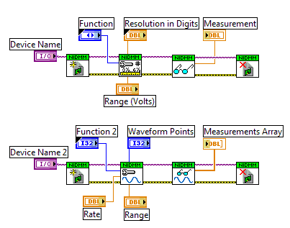
Programming with NI-DMM :Digitizer Mode
DMM Mode
Digitizer Mode
Notes:
Digitizer mode (only on 407x) — Some NI DMMs have a digitizer mode that allows them to sample at fixed time intervals and return a waveform measurement. This feature increases the flexibility of the DMM and, in some cases, can eliminate the need for an additional digitizer or MIO device. Although digitizers are typically more effective for multipoint measurements, a DMM with a digitizer mode has certain advantages such as high resolution, signal isolation, and higher input ranges. Common digitizers can accept input signals with only 10 or 20 V. NI DMMs with a digitizer mode can perform multipoint acquisitions on signals of 300 V or higher.

Slide 60
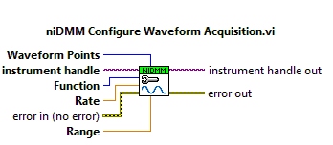
NI-DMM Programming Flow : Waveform
Use niDMM Configure Waveform Acquisition to set the sampling rate and the number of points (n) to acquire.
Allowed sampling rate values: r = 1.8 M/z, where z =1,2,3,… 1.8 M
Allowed aperture time: 8.89 µs < t aperture < 149 s
where t aperture= n / r
Notes:
The available sampling rates are 1.8M/n, where n=1,2,3,… 1.8M
The ratio between the number of points acquired and the sampling rate determines the aperture time. The minimum and maximum times for waveform acquisitions are 8.89 µs and 149 s respectively. To determine if you settings meet the required time, use the following formula:
8.89 µs < n/r < 149 s
where
n equals the number of samples
r equals the rate
For more information, refer to NI Digital Multimeters Help >> Devices Overview >> NI 407x >> Sample Rate

Slide 61

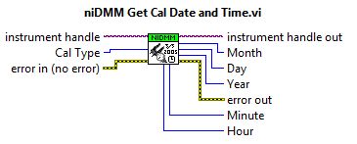

Programming with NI-DMM : Self-Calibration
Self Calibration
Only supported by NI 407x.
Only calibrate if temperature has changed more than 5 °C or if 90 days have passed.
Extends amount of time required to have an external calibration to 2 years.
Notes:
The NI-DMM incorporates a self-calibration procedure, which extends the amount of time required to have an external calibration to two years. It can acquire both AC and DC-coupled waveforms up to ±300 V input.
The NI 407x has a self-calibration function that allows you to perform a calibration at the temperature you are making your measurements. Self-calibration fully recalibrates all ranges for DC volts and resistance. Self-cal compares measurements to on-board, high-precision, NIST traceable standards which removes errors due to temperature variation and long term drift. Self-cal takes less than 60 seconds and requires no external precision sources or fixturing.
Self-calibration makes the NI 407x accurate and stable at most temperatures (0-50°C)-well outside of the traditional 18 to 28 ºC. Self-calibration also accounts for all resistance, source, gain, and offset errors. By simply placing a different instrument next to your DMM can increase the temperature, thus requiring you to run a self calibration.
If you change your setup or put the DMM in another chassis you should run Self-Calibration.
For information on best practices when taking low resistance measurements, refer to:
Interactive tutorial “Eliminating Accuracy Errors with Self-Calibration” available at http://zone.ni.com/wv/app/doc/p/id/wv-249.
NI-DMM Help >> Devices >> NI-407x >> Self-Calibration

Slide 62
Exercise 3-2: Programming the DMM
Benchmark the measurement cycle for various configurations.
Notes:
Have the students turn to Exercise 3-2 in their DMM exercise manuals and complete the exercise.
Est time: 40 min.

Slide 63
Summary – Quiz
Which of the following are common DMM measurements?
Voltage
Current
Resistance
Pressure
Notes:
Voltage
Current
Resistance

Slide 64
Summary – Quiz
Use the ______ to make measurements without any programming.
NI-DMM Soft Panel
NI-DMM VIs
LabVIEW
Notes:
a) NI-DMM Soft Panel

Slide 65
Summary – Quiz
Which of the following shows the correct NI-DMM programming flow?
Initialize > Configure Hardware > Read/Fetch Data > Close
Initialize > Read/Fetch Data > Configure Hardware > Close
Configure Hardware > Initialize > Read/Fetch Data > Close
Notes:
a) Initialize > Configure Hardware > Read/Fetch Data > Close

Slide 66
Lesson 4 Advanced DMM Topics
High Accuracy/Low Noise
Measurement Cycle
Optional Features
Notes:
The primary difference between DMMs and other types of analog input devices are their specifications and features. Therefore, it is essential to understand these specifications, and to know which are most important.

Slide 67
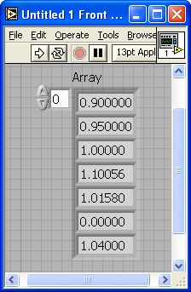


A. High Accuracy/Low Noise
DMMs return one calibrated reading made up of many sampled points.
DAQ devices return every sampled point.
100ms
100ms
Measurement
Cycle
Measurement
Cycle
Notes:
DAQ or Digitizer boards are synchronized devices that return every digitized sample to the user, often in the form of an array.
DMMs have a free running clock that digitizes the waveform, similar to DAQ device, but instead of returning every point, the sampled values are averaged. By averaging the samples, the DMM is able to achieve much higher resolution than DAQ devices. DMMs also achieve higher resolution by using extremely low noise components and provide built-in signal conditioning and noise rejection, among other measurement option functions.

Slide 68
B. Measurement Cycle
Input
Trigger
Measurement
Complete
Notes:
DMM modular instruments perform a series of tasks, collectively known as the measurement cycle, each time you request a measurement. The DMM measurement cycle contains several measurement phases:
Switch Time
ADC Calibration
AutoZero
Settle Time
Aperture Time
The length of the measurement cycle determines the rate at which measurements are taken and returned. Enabling optional tasks such as AutoZero or ADC Calibration can extend the measurement period.
Here we have illustrated the measurement cycle for the NI 407x.

Slide 69
Switch Time
Required to configure the internal analog circuitry of the DMM for the next measurement
Cannot be controlled
Multi-point acquisitions with same configuration, switching time is larger for the first sample
In subsequent samples, the switching time is optimized to its minimum
Notes:
Switch time is required to configure the internal analog circuitry of the DMM for the next measurement. It is not something that you can control. The switching time is internal to the DMM and always occurs. In multi-point acquisitions where all samples use the same configuration (range, function, etc.) the switching time is larger for the first sample. For subsequent samples, the switching time is optimized to its minimum.

Slide 70
Auto Range
Range of a measurement is the maximum absolute value of the signal being measured
NI DMMs with auto range capabilities can calculate the approximate range for signal
Enable auto range increases measurement period
Available modes: ON, OFF, and ONCE
Notes:
The range of a measurement is the maximum absolute value of the signal. In order to set a measurement range, you must know the approximate value of the signal. When you do not know an approximate range for a signal, DMMs with auto range capabilities can calculate an approximate range. With auto range enabled, the DMM takes a series of measurements and adjusts the range until the measurement falls within the smallest range appropriate for that measurement. Enabling auto range increases the measurement period, because the DMM must measure the signal multiple times to determine the range before taking the primary measurement.
The auto range can be programmatically configured with NI DMMs. The available auto range modes are ON, OFF and ONCE. When auto range is set to ONCE, an auto range measurement is performed at the beginning of a series of measurements and then used throughout the series.

Slide 71
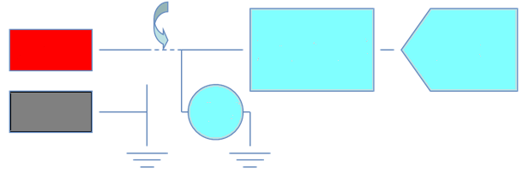

ADC Calibration
Compensates for gain errors by comparing reference measurements to calibrated information
Hi
Front End
ADC
Lo
7 V
Tips: -
Disable ADC calibration to increase speed
Increase reading rate up to 2x
Add 3 ppm/ºC
Self-calibrate periodically
Notes:
ADC calibration exists on some DMMs to eliminate internal gain error in the device. When enabled, the DMM uses its ADC to read the value of a high precision voltage reference before each measurement. The DMM uses the measured voltage to correct any gain error in the ADC. ADC calibration is not necessary for all measurements. In general, only DC Voltage or resistance measurements at high resolution benefit from the additional precision provided by ADC calibration. When not necessary, disable ADC calibration, because ADC calibration increases measurement time.
You can configure ADC calibration programmatically on NI DMMs. The available modes for ADC calibration are ON, OFF, and AUTO. When ADC calibration is set to AUTO, the DMM chooses whether to use ADC calibration based on the measurement configuration.
When ADC calibration is disabled, use device self-calibration to reduce gain errors in the ADC. For more information on determining an appropriate self-calibration schedule for your DMM, refer to the Self-Calibration topic in the NI Digital Multimeters Help.

Slide 72
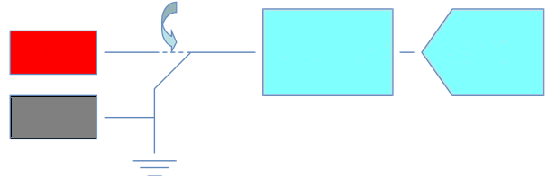
AutoZero
Compensates for offset errors by subtracting a zero reading from the measurement
Hi
Front End
ADC
Lo
Tips: -
Disable AutoZero to increase speed
Allow a 0 minute warm-up
Add 2 ppm/ºC
Self-calibrate with temperature drift
Notes:
AutoZero is a method used to compensate for internal DMM offsets. When AutoZero is enabled, the DMM internally disconnects the input and takes a zero reading. Then, the DMM subtracts the zero reading from subsequent measurements. This prevents offset voltages present on the input circuitry of the DMM from affecting measurement accuracy. You can configure AutoZero programmatically on NI DMMs. The available auto zero modes are ON, OFF, AUTO, and ONCE. When AutoZero is set to AUTO, the DMM chooses whether to use AutoZero based on the measurement configuration. When AutoZero is set to ONCE, the DMM performs an AutoZero measurement at the beginning of a series of measurements and then uses the measurement throughout the series. When AutoZero is disabled, the DMM uses the value of the AutoZero during the last calibration.

Slide 73
Using the AutoZero Feature
Demonstrate the usefulness of the AutoZero feature of the 407x DMM.
Notes:
Follow the instructions in <Exercises>\DMM\Demonstrations\AutoZero_DemoScript.doc

Slide 74
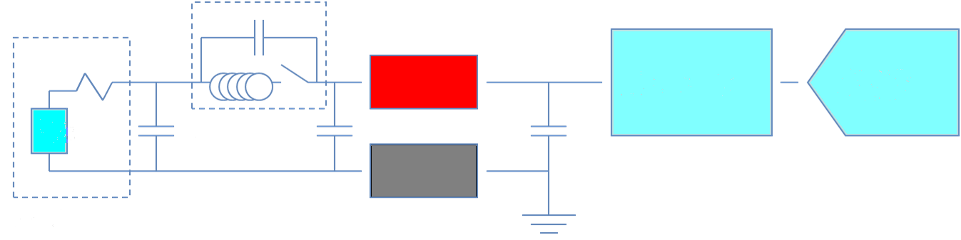
Settling Time
Allows transients to reach steady state before sampling
Hi
Front end
ADC
Voltage
Switch
Lo
Settling Time = kRC
Important for resistance > 10 k Ω
Tip: To improve resolution, increase settling time when switching
Notes:
Settling time is the time required for a measurement system to stabilize to a specified accuracy limit. Factors in the system that might affect the required settling time include measurement type, measurement range, cable properties, source impedance, and multiplexers or switches within the system. Settling time becomes especially important in scanning or switching systems. A scanner or multiplexer requires additional settling time before the DMM can take a measurement. The settling time property allows the DMM to adjust for switch settling time.
Note: DMM/Switch systems synchronized using the handshaking trigger mode do not need to adjust DMM settling time because triggers control the start of each measurement.
NI-DMM allows you to control settling time programmatically. Default settling times depend on the measurement type and range. For more information on the default settling times and how to determine appropriate settling time for advanced systems, refer to the DMM Measurement Defaults topic of the NI Digital Multimeters Help.

Slide 75
Aperture Time
Aperture time is the period during which the ADC is reading the input signal.
You can specify aperture time either in seconds or power line cycles (PLCs).
Resolution, measurement speed and frequency rejection are functions of aperture time.
Aperture time =
Resolution
Measurement Speed
Notes:
Aperture time is the period during which the ADC is reading the input signal. Resolution, measurement speed, and frequency rejection are functions of the aperture time. The larger the aperture time, the better the resolution. Select short aperture times for faster measurement speed. You can specify aperture time either in seconds or in power line cycles (PLCs).
The larger the aperture time, the better the resolution. Select short aperture times for faster measurement speed.
During the aperture time many measurements are taken by the DMM and basically averaged together to return a single sample. Acquiring more points and averaging them usually cancels out more noise. If a system is in a low noise environment and proper shielding and cabling is used then the aperture time may be lowered without experiencing a large difference in resolution. Another source of noise is power line noise and the aperture time can be set to a multiple of the power line to cancel out any 50 or 60 Hz noise. (1 power line cycle (PLC) at 60 Hz is 16.67ms)
By manually setting the aperture time the absolute resolution value is ignored. Therefore if you specify a 6.5 digit measurement earlier in your code this programmatically determines the aperture time. If you then manually set a smaller aperture time then you may no longer be at 6.5 digits since the aperture time is related to the resolution. However, even though the two are related, the aperture time can still be tweaked to achieve faster reading rates while maintaining the same resolution depending on the measurement.
By adjusting the above measurement cycle phases a DMM can be optimized to not only acquire at a specified resolution but also at a faster speed.

Slide 76
Aperture Time :DCNR
Many measurements are taken during the aperture time and averaged to return a single sample
Acquiring more points and averaging them cancels noise
By adjusting the relative weight of the samples, can adjust sensitivity to different interfering frequencies
Notes:
DC Noise Rejection (DCNR)
DC noise rejection is a configurable noise reduction feature available for NI 4070/4071/4072 DC measurements. Each DC reading the NI 4070/4071/4072 returns is actually an average of multiple high-speed samples. By adjusting the relative weighting of those samples, you can adjust the sensitivity to different interfering frequencies.

Slide 77
Aperture Time : DCNR
Three different modes for DCNR:
Normal
Second-order
High-order
The lowest frequency for DC noise rejection (DCNR) is a function of aperture time
DCNR Setting | Lowest Frequency for Noise Rejection
Normal | >fo=1/taperture
Second-order | >fo=2/taperture
High-order | >fo=4/taperture
Notes:
The NI 4070/4071/4072 offers three different modes: normal, second-order, and high-order.
The lowest frequency for noise rejection is a function of the aperture time.
Each DC reading the NI 407x returns is actually an average of multiple high-speed samples. DC Noise Rejection (DCNR) allows you to adjust the relative weighting of those samples. By doing this, you can adjust the sensitivity to different interfering frequencies, therefore suppressing the noise coupled onto a measurement.

Slide 78
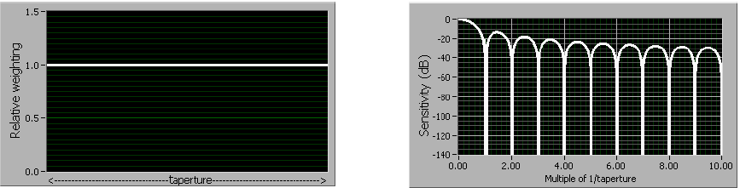
Aperture Time : DCNR
Normal rejection mode
Emulate behavior of most traditional DMM
Rejection of frequencies at multiples of f0, where f0 = 1/t_{aperture}
Notes:
Normal
When you select normal DC noise rejection, the NI 4070/4071/4072 weights all samples equally. This feature emulates the behavior of most traditional DMMs, providing good rejection of frequencies at multiples of f0, where f0 = 1/t_{aperture}. The following figure shows normal weighting, where all samples are weighted equally, and the resulting noise rejection as a function of frequency. Notice that you can obtain good rejection only very near multiples of f0. To get the fastest possible readings that give you some power line noise rejection, set the aperture to the power line period, such as 16.667 ms for a 60 Hz power line frequency, and set the DC noise rejection to normal.

Slide 79
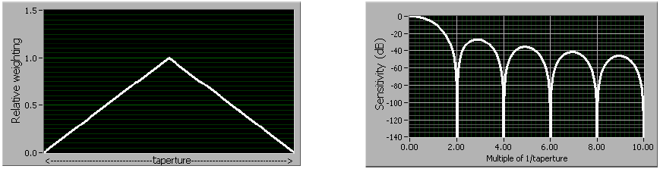
Aperture Time : DCNR
Second-order rejection mode
Triangular weighting of measurement samples throughout the aperture time period
Samples taken in the middle of aperture time weighted more
Rejection of frequencies at multiples of f0, where f0 = 2/t_{aperture}
Notes:
Second-order (Tri)
Second-order DC noise rejection applies a triangular weighting to the measurement samples, as shown in the following figure. In second-order DC noise rejection, the samples taken in the middle of the aperture time are weighted more than samples taken at the beginning and the end of the measurement.
Notice that you can obtain very good rejection near even multiples of f0 and that rejection increases more rapidly with frequency than with normal sample weighting. Also notice that the response notches are wider than they are with normal weighting, resulting in less sensitivity to slight variations in noise frequency. Use second-order DC noise rejection if you need better power line noise rejection than you can get with normal DC noise rejection, but cannot afford to read slowly enough to take advantage of high-order noise rejection. For example, you could set the aperture to 33.333 ms for a 60 Hz power line frequency.

Slide 80
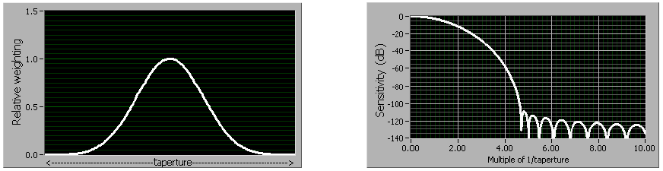
Aperture Time : DCNR
High-order rejection mode
Bell shaped weighting of measurement samples
Rejection of frequencies at multiples of f0, where f0 = 4/t_{aperture}.
Notes:
High-order (Kaiser)
High order applies a bell-shaped weighting of measurement samples throughout the aperture time period.
Notice that noise rejection is good starting at around four times f0 and is excellent above about 4.5 times f0. Sensitivity to noise at any frequency above 4.6 times f0 almost does not exist. An NI 4070/4071/4072, using high-order DC noise rejection with a 100 ms aperture (10 readings/sec), can deliver full 6½ digit accuracy with over 1 V of interfering power line noise on the 10 V range at any frequency above 46 Hz.
The small tradeoff to using the higher-order filters is that to obtain powerline rejection, you must increase the measurement aperture by 2x (for second-order) or 4x (for high-order) versus that required for the normal setting. The increase in aperture time is typically minimal given the reduction in the interfering signal.

Slide 81
Aperture Time – DCNR (cont) - Hidden
Notes:
Choosing different DCNR will affects your measurement speed, because you must increase the measurement aperture by 2x (for second-order) or 4x (for high-order). The DCNR setting you use will depend on the level of noise you have on your measurement. Normal noise rejection provides the fastest measurement rates, provided you know the exact frequency of the noise source, for example, your power-line frequency. High order rejection provides suppression of a wide span of noise frequencies at the cost of slowing measurement rates. For example, if you have a very noisy environment (a noisy power line or a signal with different frequency components), you can run faster using the High-Order DCNR because it only requires you to take a single measurement due to the high level of noise rejection. In Normal DCNR, you would have to average several points to get the same level of noise rejection, thus reducing your overall throughput.
Note: For more information, refer to the following topics of the NI Digital Multimeters Help:
DC Noise Rejection
Aperture Time
Selecting Aperture

Slide 82
C. Optional Features
Capacitance/ Inductance Measurements (NI 4072)
Digitizer Mode (NI 407x)
Allows DMM to sample at fixed time intervals and return waveform measurement
Allow waveform measurements with large range and high isolation
Notes:
Additional features are available on some DMMs:
Inductance and Capacitance Measurements – Some DMMs can measure inductance and capacitance in addition to the standard voltage, current and resistance measurements.
Digitizer Mode – Some NI DMMs have a digitizer mode that allows them to sample at fixed time intervals and return a waveform measurement. This feature increases the flexibility of the DMM and, in some cases, can eliminate the need for an additional digitizer or DAQ device. While typical digitizer devices are effective for multipoint acquisitions involving high resolution, signal isolation, and higher input ranges, a limiting factor of common digitizers it that they can accept input signals only in the range of 10 or 20V. NI DMMs with a digitizer mode can perform multipoint acquisitions on signals of 300V or higher.

Slide 83
Summary – Quiz
Which of the following could you turn off to reduce your measurement time?
Notes:
Answer: You can turn off ADC Calibration and AutoZero to reduce your measurement time. The others cannot be turned off.

Slide 84
Lesson 5 DMM and Switches
DMMs and Switching
Scanning mode : synchronous
Scanning mode: handshaking
DMM/Switch Connection
DMM/Switch Express

Slide 85
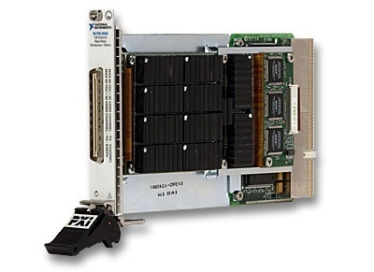
A. DMM and Switches
DMMs are often used with switches to extend the number of signals to which a DMM can be connected
DMMs are high performance, high precision devices, but only have one channel
Use switches to multiplex connections to multiple channels
Notes:
Switches are often used with DMMs. DMMs are high performance devices designed to make precise measurements. They are limited to one set of channel connections. If you want to use the precise measurements on multiple different signal measurements you should use of a switch product.

Slide 86
DMM and Switches : Scanning
Scanning on a switch is used when timing of a connection needs to be synchronized with hardware event (Measurement Completed event on DMM)
Scanning can be performed with most switches
All SCXI switches except: 1160, 1161, 1163R, 1190, 1191
All PXI switches
Two types of hardware-timed scan options:
Synchronous scanning
Handshaking scanning
Notes:
Scanning on a switch is often used when the timing of a connection needs to be synchronized with some sort of hardware event, like a measurement being completed on a DMM. Scanning consist of a list of connections to be made when an event is detected. The connections are entries in a scan list that is exported to the memory of the switch. The first entry of the scan list is executed when the switch module is armed and the trigger settings of the switch will determine when to advance through the list.
Scanning depends on the type of switch being used (not all switches can scan):
All SCXI switches Except: 1160, 1161, 1163R, 1190, 1191
All PXI switches
Scanning also depends on system setup:
PXI Chassis or SCXI chassis
Cabling
Controller
There are two hardware-timed scan options: Synchronous Scanning and Handshaking Scanning

Slide 87

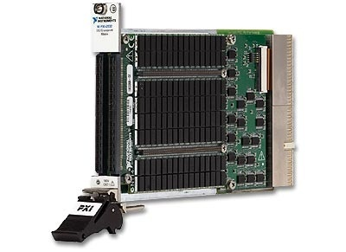
B. Synchronous Scanning
Measurement Complete
Trigger Input
Input Trigger
Measurement Complete
Notes:
When the DMM is in a mode that is regularly making measurements. As it finishes its measurement cycle it is programmed to generate a digital pulse called the Measurement Complete (MC). When the switch receives this digital pulse as a Trigger Input (TI), the switch will advance to the next entry of the scan list.

Slide 88

Synchronous Scanning
Program the DMM interval time between measurements to allow time for the switch to activate and settle.
where:
M = measurement
WFT = wait for trigger
S&S = switch and settle

Slide 89
C. Handshaking Scanning
Measurement Complete
Trigger Input
Input Trigger
Scanner Advance
Notes:
Handshaking scanning mode is very similar to synchronous scanning, but the switch is now sending a signal Scanner Advance (SA) back to the DMM after each set of connections. The DMM does not need to be programmed to take measurements at regular intervals but rather to accept a pulse as a trigger for its measurements. The DMM needs to be armed and ready to accept a trigger for its first measurement. The switch is then armed, executes its first entry in the scan list, generates the SA trigger and waits for a digital pulse to execute its next entry. When the DMM receives this digital pulse, it takes the first measurement and generates the MC. When the switch receives this digital pulse, it executes the next entry in the scan list, generates another SA and so on.

Slide 90
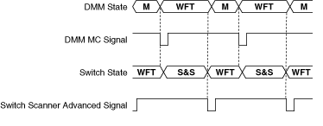
Scanning Mode: Handshaking
No longer need fixed intervals between measurements
Switching the switch and measurements on the DMM depend on triggers
where:
M = measurement
WFT = wait for trigger
S&S = switch and settle

Slide 91
Exercise 5-1: Scanning Modes
Take measurements with an NI digital multimeter using synchronous scan mode and handshaking scan mode.
Notes:
Have the students turn to Exercise 5-1 in their DMM exercise manuals and complete the exercise.
Est. time: 30 min.

Slide 92
D. DMM/Switch Control
Switch selection based on signal type and topology
NI DMMs often paired in PXI or SCXI switch system configurations
DMM can be used as a controller for the switch
Still need to physically connect the signal from the switch to the front panel of the DMM
Notes:
In applications where you are connecting many test points to the DMM, it is appropriate to incorporate a switch. Switches are used to route signals between test points and instruments.
Switch selection should be based on the signal types you are routing and the switch topology required.
After a suitable switch is selected, the type of controller and cabling solution can be determined. NI DMMs are often paired in PXI or SCXI Switch system configurations.

Slide 93
DMM/Switch Control: Configurations
There are several tables that describe the different configurations of a DMM and a switch.
The system configuration depends on the controlling module of the switch.
For more information on configuring the connection between a DMM and a switch, refer to Scanning Switch Modules in the NI Digital Multimeter Help and the Switch/DMM Hardware Configurations article in the KnowledgeBase.
Notes:
This is one of several tables that describes the different configurations involving a DMM and switch. The system configuration depends on the controlling module of the switch. For more configuration tables like this one, refer to the Scanning Switch Modules topic of the NI Digital Multimeter Help.
The different form factors for switches are PXI and SCXI.
Switch/DMM Hardware Configurations
http://digital.ni.com/public.nsf/allkb/DED0DF9FD49D1904862571240050871F

Slide 94
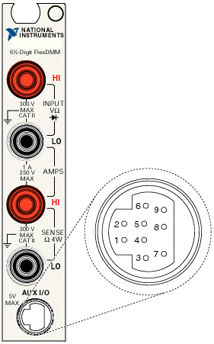
DMM/Switch Control: PXI + SCXI
NI 406x and NI 407x controls SCXI chassis through its 9-pin serial connector
DMM AUX connector is used for digital communication and triggering, no analog signals are passed
Controls SCXI switch and digital modules as well as the NI SCXI-1124 analog output module
Notes:
The PCI/PXI 4065 and PCI/PXI 407x can control an SCXI chassis. However, it cannot digitize signals on the SCXI analog bus.
The 407x and 4065 can control an SCXI chassis through its 9-pin serial-type connection. If you are connecting to an SCXI 1127, 1128, or 1129 switch module, you should use the SCXI-1357 High Voltage Backplane kit to connect the DMM with the SCXI chassis. If you wish to connect to any other SCXI module, you should do so using the SCXI-1362 connector.
Many SCXI modules, such as the 1100, 1102, and 1121, are for analog signal conditioning. These modules filter, amplify, and isolate analog signals to before a DAQ board digitizes them using analog input operations. The 4065 cannot see the SCXI analog bus that these modules use. Therefore, you cannot gain any useful signal conditioning from these modules in conjunction with a DMM. However, you can route the analog signals from your SCXI switch modules to your DMM using the HV8-BAN4 cable with the 1357/1362 adapter kit.

Slide 95
DMM/Switch Control: PXI + SCXI (cont.) – Hidden)
Notes:
If the 407x or 4065 cannot benefit from SCXI analog signal conditioning, what’s the point of using SCXI? The answer is that all other SCXI functions can be controlled through the DMM. The most common module used with the 4065 is the SCXI-1127 multiplexed. The 407x and 4065 can control all SCXI digital and switch modules (1160, 1161, 1163R, 1190, 1191, 1192) as well as the 1124 analog output module.
The 407x can also control any DAQmx SCXI switch if the user has NI-DMM 2.2 or later installed.
When a 407x or 4065 is used for SCXI control, the chassis is added exactly as it would be with an E series card. The module auto-detection feature can be used. Furthermore, a 407x or a 4060 in the right most slot of a PXI-1010 or PXI-1011 chassis can control the SCXI system through the PXI-SCXI internal bus just as an E series board.

Slide 96
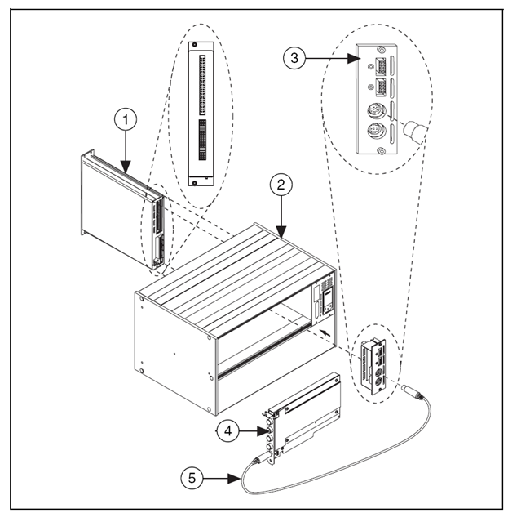
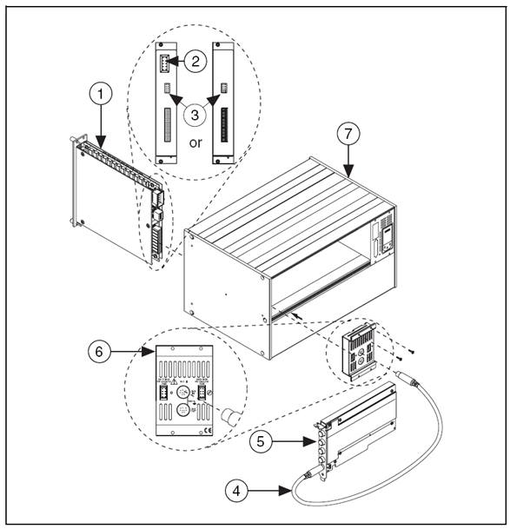
DMM/Switch Control: PXI + SCXI
Notes:
NI SCXI switches have two different connector options. To connect to switches with a large connector, use the SCXI-1362. To connect to switches with small connectors, use the SCXI-1357.

Slide 97
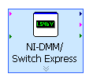
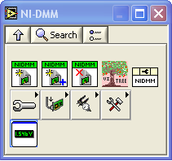
E. DMM/Switch Express VI
NI-DMM 2.5 introduced the NI-DMM/Switch Express VI which automatically handles the triggering and coding required for synchronous or handshaking scanning modes
NI DMM/Switch Express VI can be used independently without switches to make normal DMM measurements

Slide 98
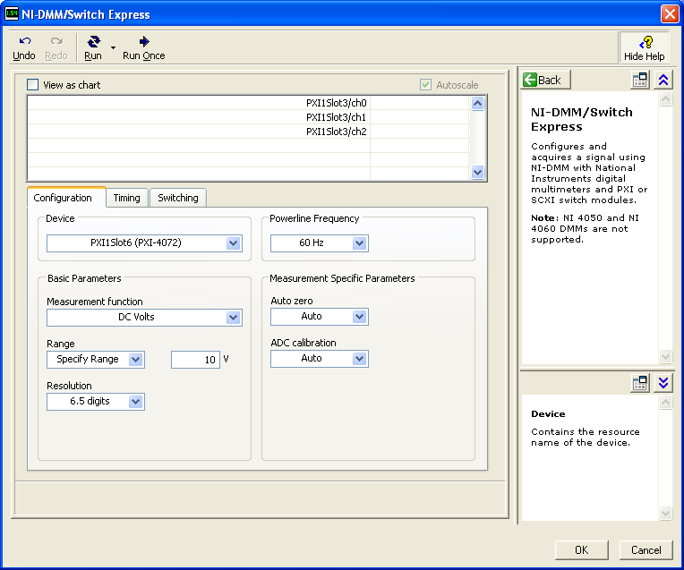
DMM/Switch Express VI: Configuration Tab
Configuration tab specifies which DMM device to use and the desired measurement configuration

Slide 99
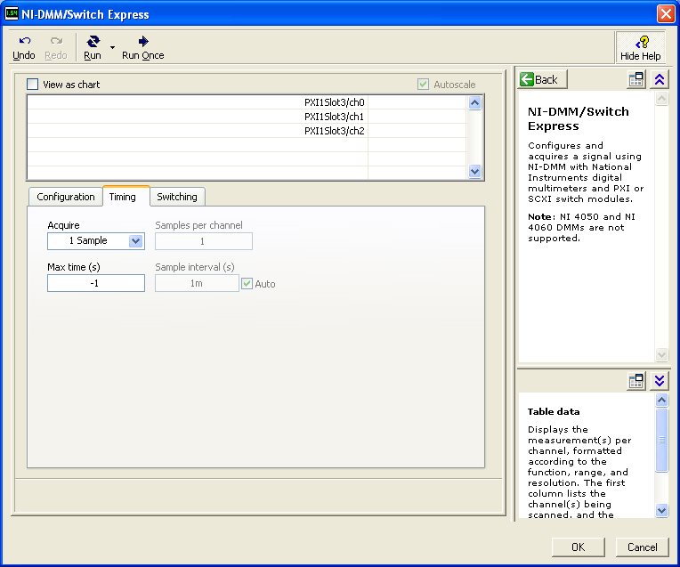
DMM/Switch Express VI: Timing Tab
Timing tab configures the timing of measurements:
1 Sample
N Samples
Continuous

Slide 100

DMM/Switch Express VI: Switching Tab
Switching tab configures which switch and channels to use in scanning mode with the DMM

Slide 101

DMM/Switch Express VI: Advanced Configuration
Advanced Configuration dialog box configures what Scanning Mode to use as well as the trigger lines

Slide 102
Summary – Quiz
True or False: DMMs are high resolution accurate devices with one channel.
Notes:
Answer is True.

Slide 103
Summary – Quiz
DMMs are often used with ______ to extend the number of signals to which a DMM can be connected.
Switches
Resistors
Calibration
Notes:
a) Switches.

Slide 104
Summary – Quiz
Which of the following are types of hardware-timed scan methods?
Synchronous Scanning
Handshaking Scanning
Calibration Scanning
Auto Zero
Notes:
a) Synchronous Scanning and b) Handshaking Scanning are the valid answers.

Slide 105
Summary – Quiz
Which of the following can generate the triggering and coding required for synchronous or handshaking scanning modes?
DMM/Switch Express VI
niDMM Initialize VI
niDMM Read VI
Notes:
a) DMM/Switch Express VI.

Slide 106
Additional Resources
DC Voltage Measurements
http://zone.ni.com/devzone/cda/tut/p/id/3226
AC Voltage RMS Measurements
http://zone.ni.com/devzone/cda/tut/p/id/2966
DC and AC Current Measurements
http://zone.ni.com/devzone/cda/tut/p/id/3225
Resistance Measurements
http://zone.ni.com/devzone/cda/tut/p/id/3981
Notes:
These are all the DevZone and KnowledgeBase articles referenced throughout the course, compiled in one list, for quick reference for the students. It gives them one last chance to review them and determine if they want to explore any of the or save them.

Slide 107
Additional Resources (Cont.)
Eliminating Accuracy Errors with Self-Calibration (Interactive tutorial) http://zone.ni.com/wv/app/doc/p/id/wv-249
Switch/DMM Hardware Configurations
http://digital.ni.com/public.nsf/allkb/DED0DF9FD49D1904862571240050871F

Slide 108
Continuing Your LabVIEW Education
Instructor Led Training
LabVIEW Modular Instruments—Switches, LabVIEW Core 2, LabVIEW Core 3
Self-Paced: a variety of instructional packages and tools designed to educate you at your own pace
Notes:
Customize this list according to the software and the level of your course.

Slide 109
Continuing Your LabVIEW Education
Training and Certification Membership upgrade
Includes access to all our regional and online classes plus all certifications from 1 yr of purchase
Please contact Customer Education at (866) 337-5918 to receive a quote for Training and Certification Membership
Apply the cost of this course to your membership if you purchase within 30 days

Slide 110
Continue Your Learning
ni.com/support
Access product manuals, KnowledgeBase, example code, tutorials, application notes, and discussion forums
Info-LabVIEW: www.info-labview.org
User Groups: ni.com/usergroups
Alliance Program: ni.com/alliance
Publications: ni.com/reference/books/
Practice!

Slide 111
Thank you!
Please complete the course survey

